Slide 1
Reinforcement Learning
Actor-Critic, GAE, and PPO
Introduction to Deep Learning: Class 7.5

Slide 2
Module outline
Class | Title | Main output
1 | Bandits, MDPs, Returns | agent/environment/reward
2 | Value Functions and Bellman Equations | Learning to solve a reinforcement learning problems by iteratively estimating the value of a state
3 | Monte Carlo, TD, SARSA, Q-Learning | On-policy vs off-policy, sampled experience
4 | Policy Gradients and REINFORCE | log-prob weighted by reward
5 | Actor-Critic and PPO | advantage, critic, clipping
6 | RLHF and GRPO | PPO/GRPO to LLM training

Slide 3
Agenda and references
Agenda:
The roles of the actor and critic.
The difference between Monte Carlo and bootstrapped advantage estimates.
One-step and n-step actor-critic.
The bias-variance tradeoff in advantage estimation.
Generalized Advantage Estimation, or GAE.
Why reusing on-policy rollouts can destabilize policy gradients.
Old-policy versus new-policy log probabilities.
Importance-sampling probability ratios.
The PPO clipped surrogate objective.
The complete PPO rollout and training loop.

Slide 4
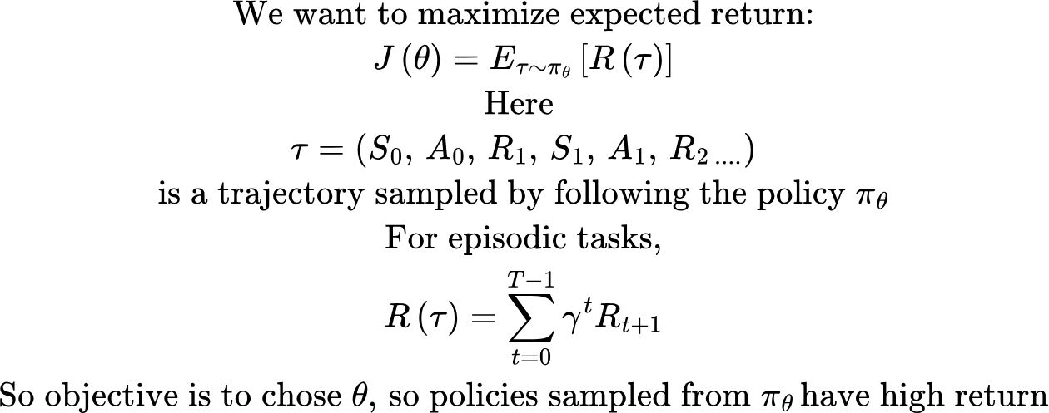
Policy objective

Slide 5
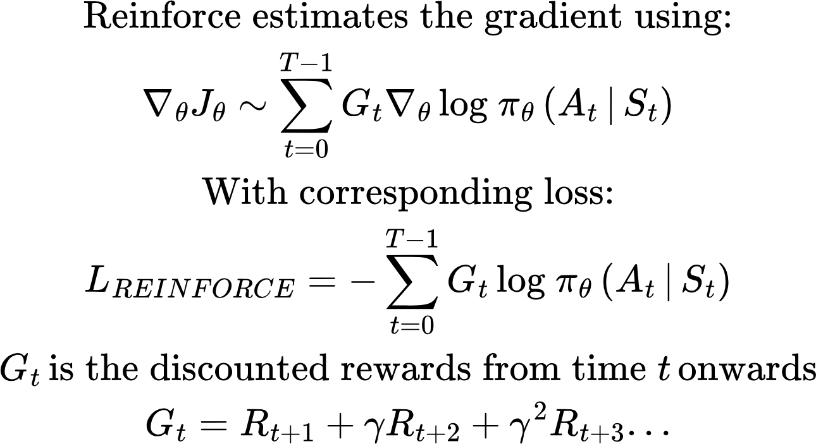
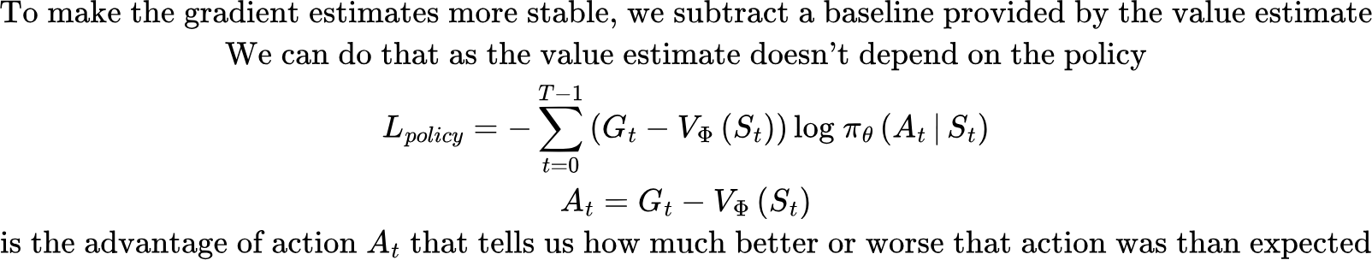
Reinforce Recap

Slide 6
Reinforce limitations
Reinforce has several limitations
It must usually wait until the episode ends.
Monte Carlo returns have high variance.
A single unusually good or bad episode can produce a large update resulting in dramatic changes in the policy

Slide 7
Actor-Critic
Actor: The policy. Decides that action to take
Critic: estimates the value of each state, i.e., the future reward the actor should expect from a state. The critic provides a learning signal to the actor. Was the outcome of this action better or worse than expected?

Slide 8
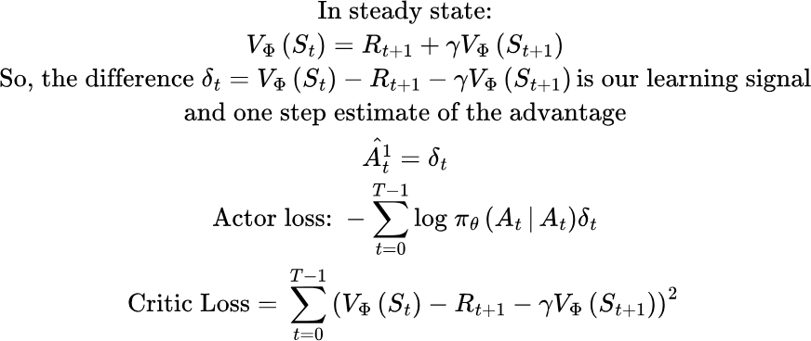
One Step Actor Critic

Slide 9
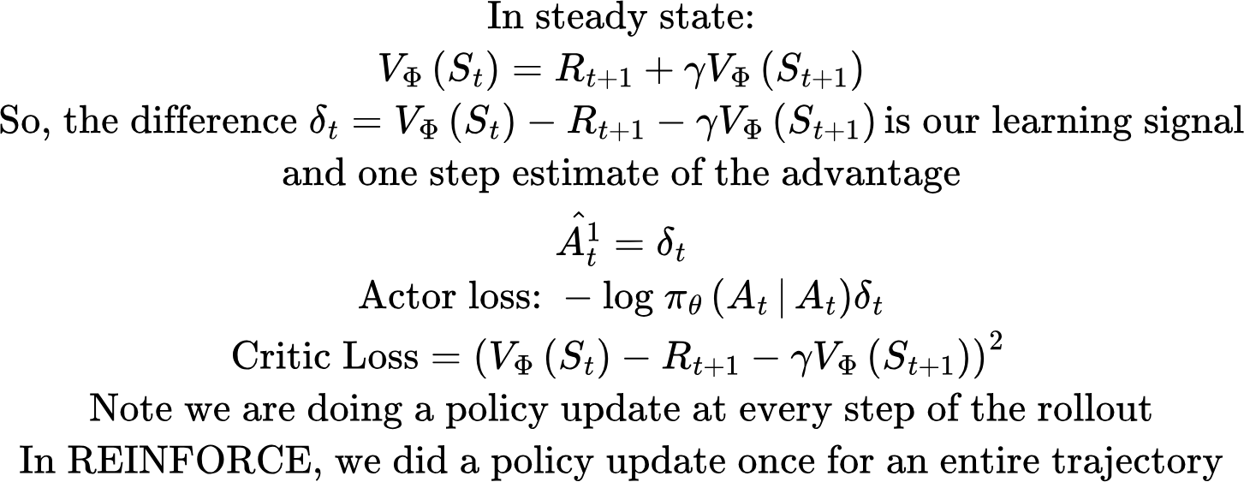
One Step Actor Critic

Slide 10
One Step Actor Critic
REINFORCE: Lower bias, high variance. Different trajectories may result in significantly different rewards
One step Actor-Critic: Potentially higher bias (if our value estimates are off), but lower variance (just one step)

Slide 11
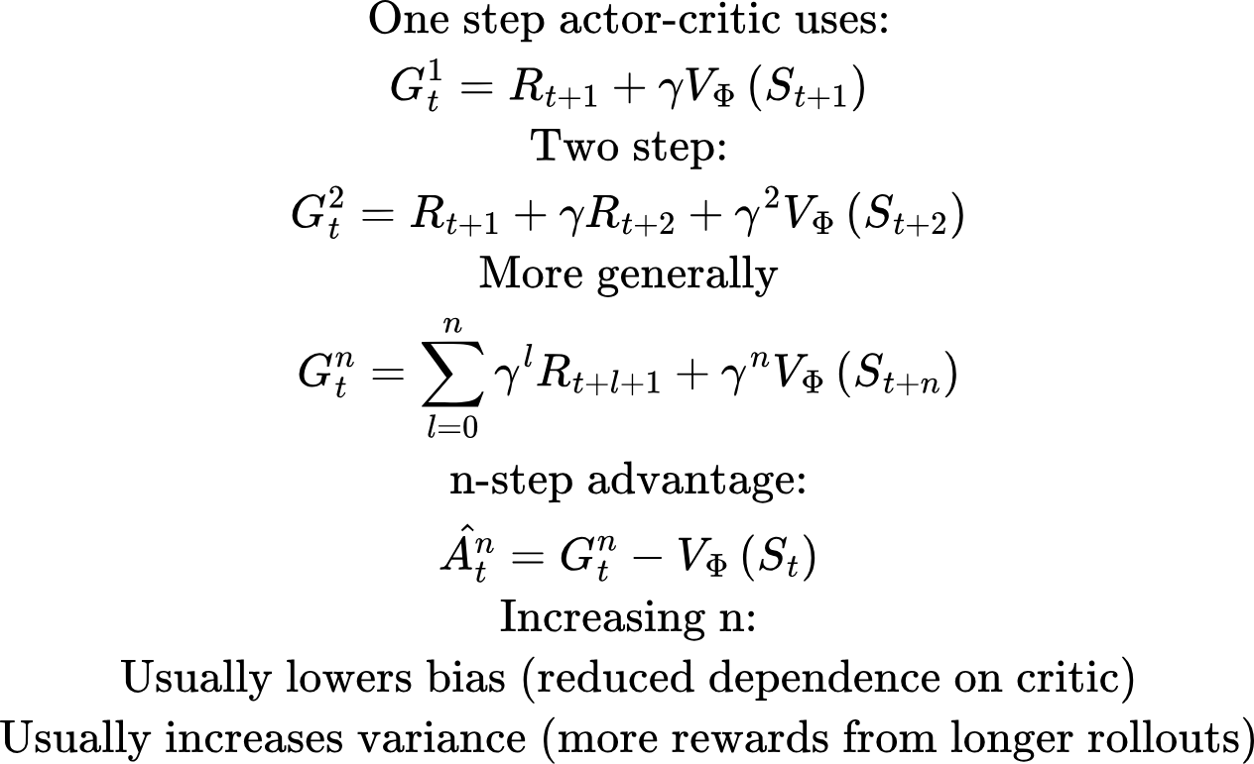
Multi-step Actor Critic

Slide 12
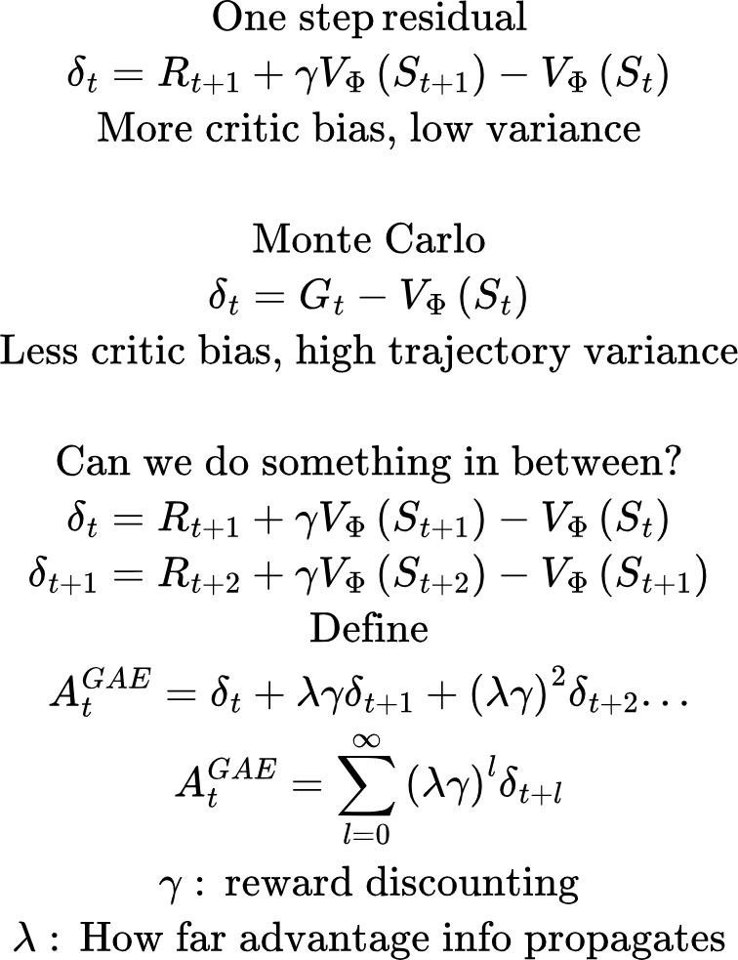
Two extremes

Slide 13
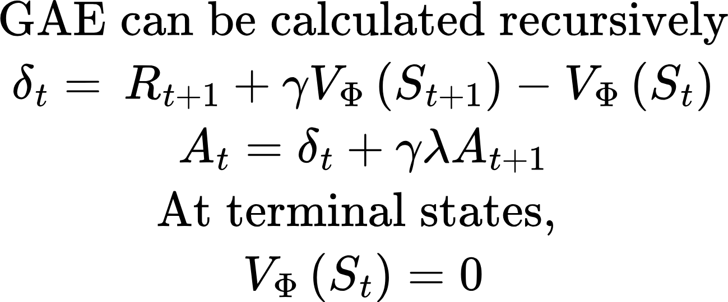
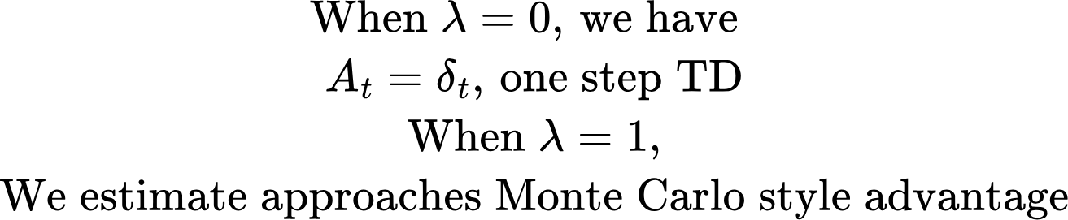
GAE: Recursive calculation

Slide 14
With GAE, policy updates can get off-policy
Reinforce: - collect trajectory with π_old - compute one gradient from that trajectory - update policy once - discard trajectory
GAE: - collect rollout with π_old epoch - minibatch 1 → update - minibatch 2 → update - minibatch 3 → update
After every update, the policy used to generate rollouts is getting increasingly out of step with the policy being updated.
Sample rollout: state s0 → action left state s1 → action right state s2 → action right
Suppose π_old(right | s2) = 0.40 π_new(right | s2) = 0.70. Suppose the advantage of this action is positive. We want to increase the probability of this action. But, the updated policy is already assigning a higher probability than the old policy.. We don’t want to encourage an even higher increase..

Slide 15
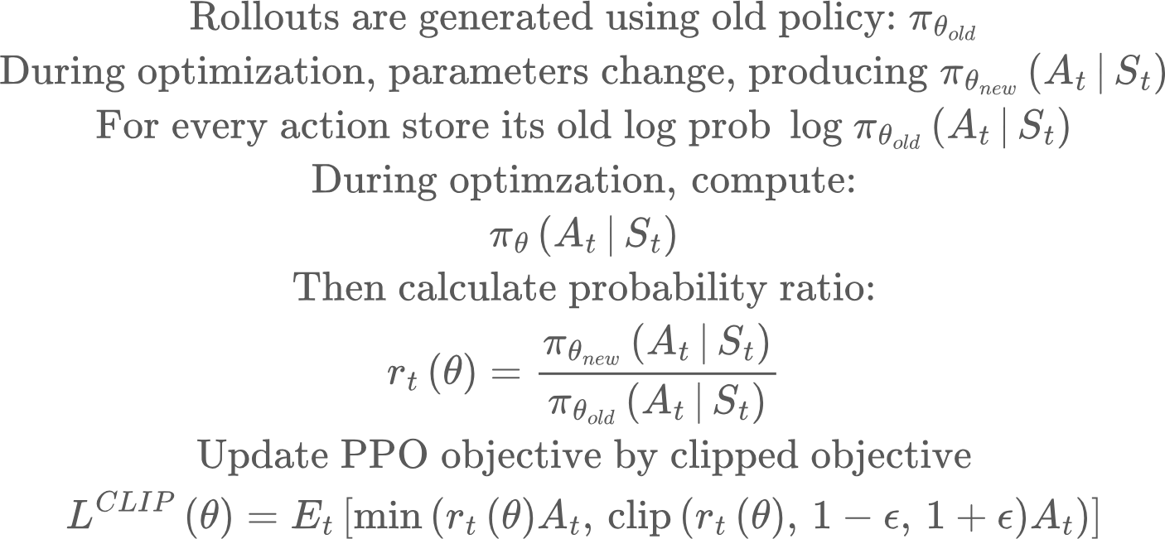
Handling off-policy updates
Say At > 1, rt = 1.1, epsilon = 0.2. Then the action At is more likely under the new policy than the old policy, and the gradient update will make it even likelier. But if rt = 1.3, clipping happens, and we have L =

Slide 16
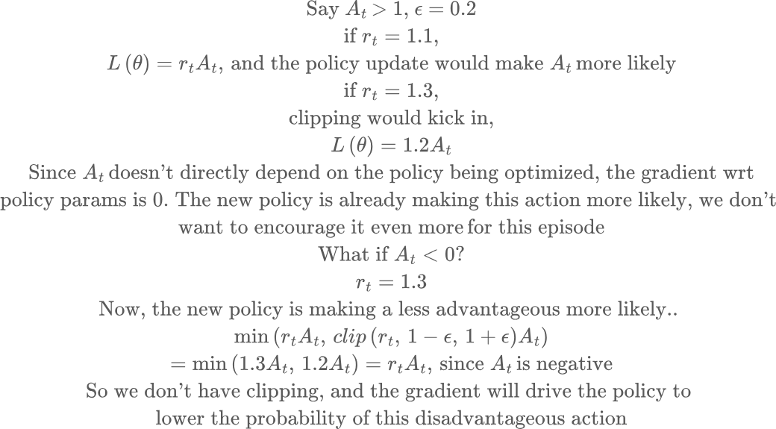
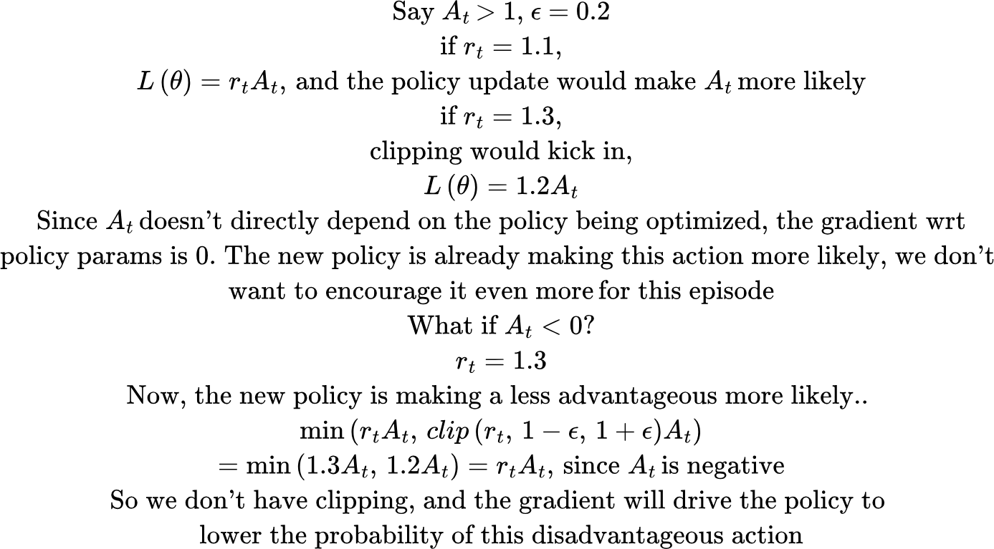

Slide 17
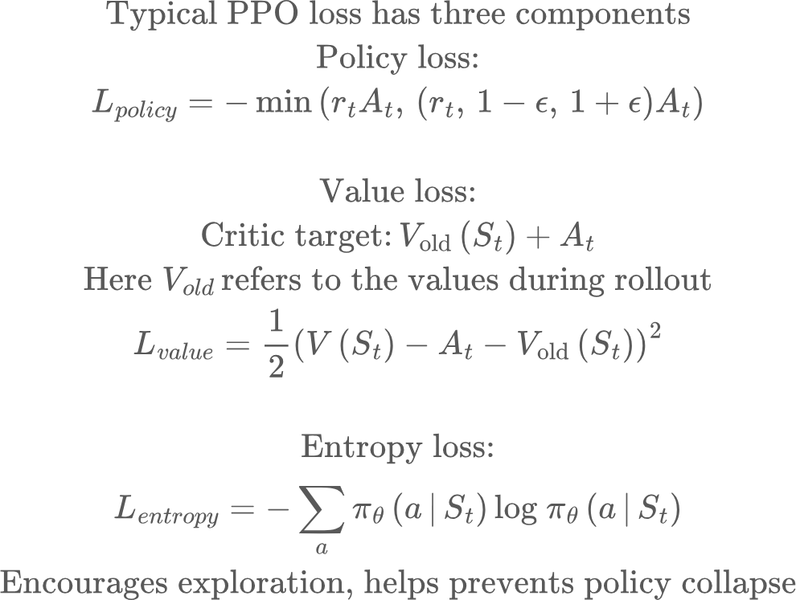
PPO: Proximal Policy Optimization

